Slide 1
Art Nouveau
Slab Containers

Slide 2
Art Nouveau
An international philosophy and style of art that was most popular during 1890–1910.
The French name "Art Nouveau" means “New Art”.
Inspired by natural forms and structures, not only in flowers and plants but also in curved lines.
Art Nouveau is considered a "total" style, embracing architecture, graphic art, interior design, and most of the decorative arts including jewelry, furniture, textiles, household silver, as well as the fine arts.

Slide 3
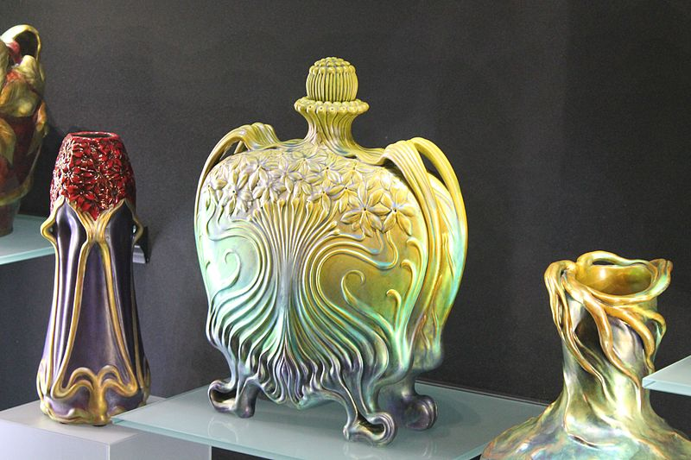

Slide 4
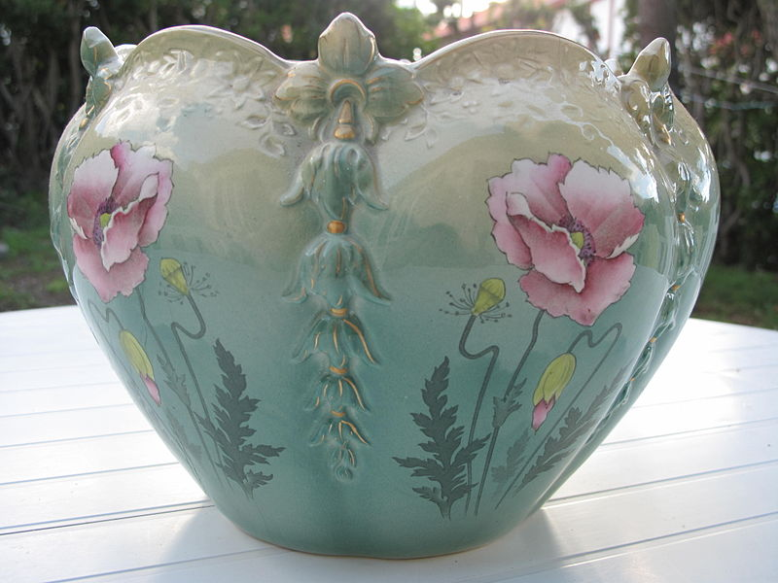

Slide 5
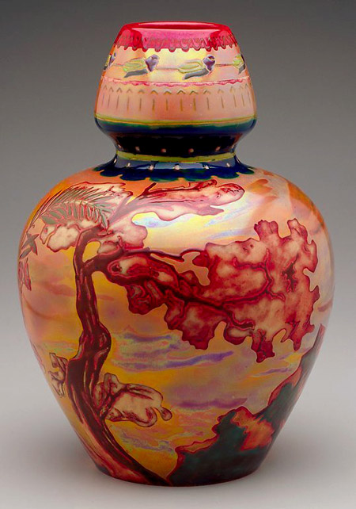
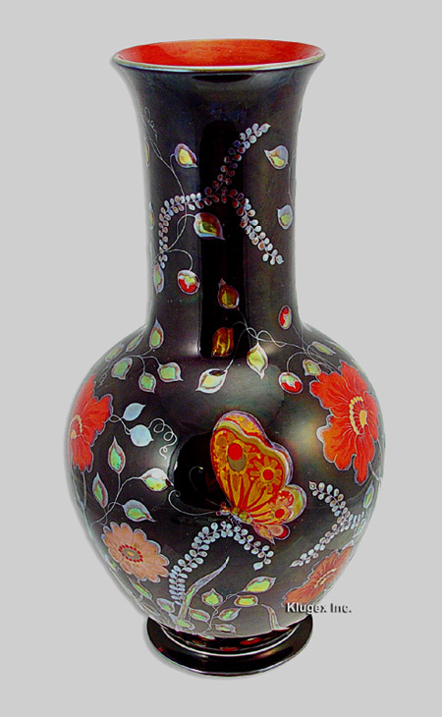

Slide 6
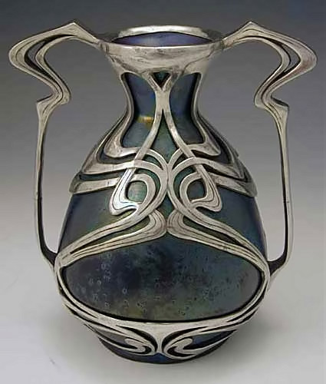

Slide 7
Marc Digeros
Originally from Minneapolis, Minnesota
Now resides in Los Angeles, California
He spent two years in Helena, MT as a resident artist at the Archie Bray Foundation and received the first ever Taunt Fellowship during his residency.
He has taught at schools in the Los Angeles area including CSU (California State University) Northridge, CSU Long Beach, as well as the University of Southern California.

Slide 8
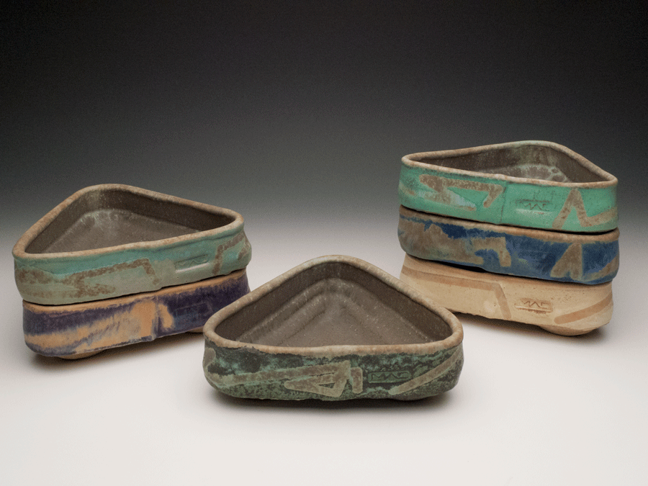

Slide 9
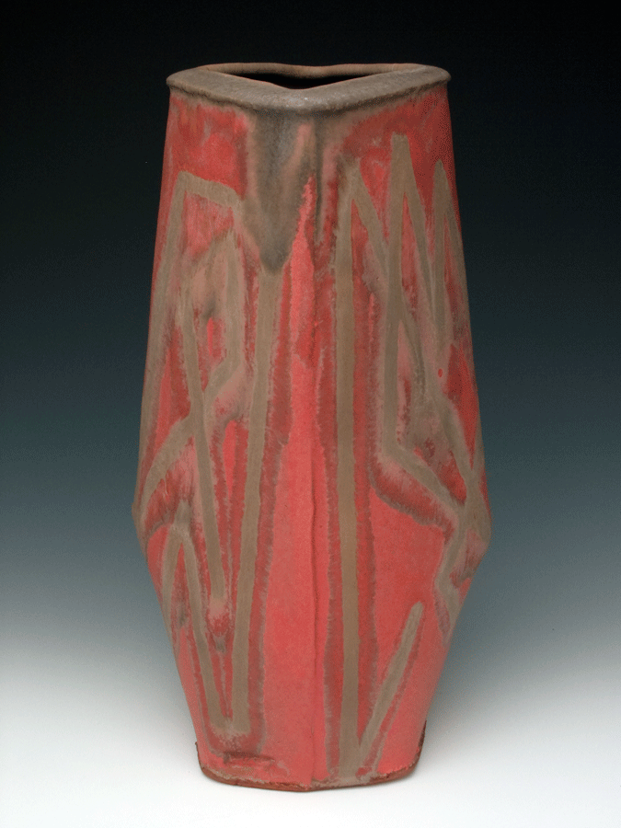
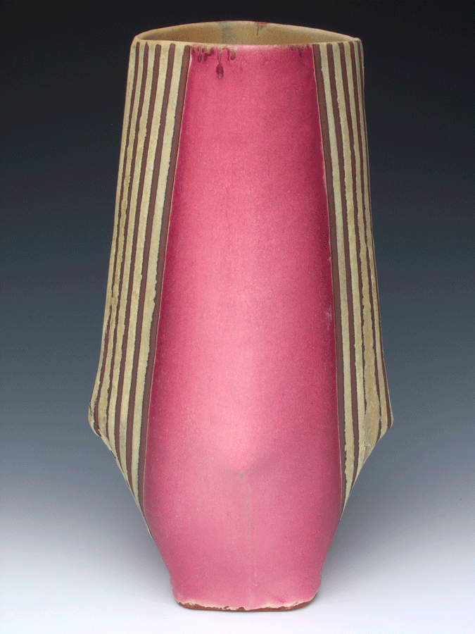

Slide 10
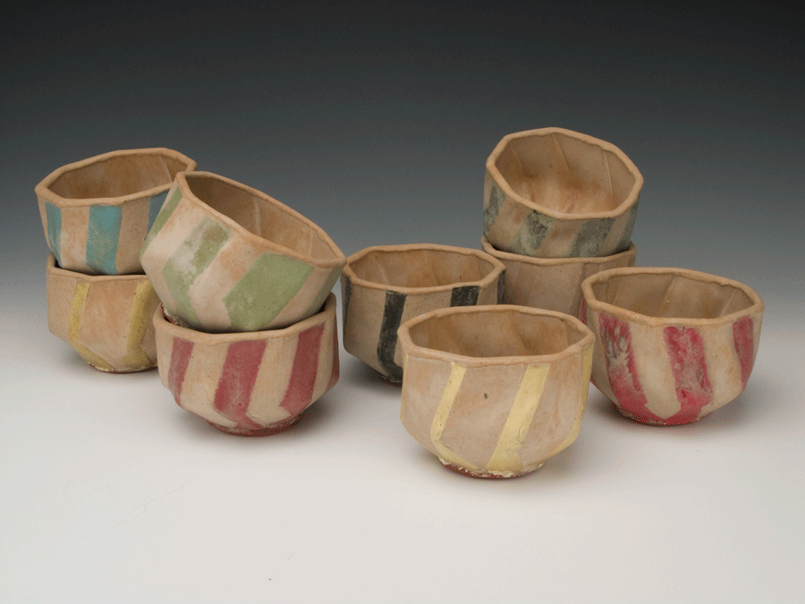

Slide 11
How To Make Your Slab Container
Create your stamp and fire it
You will need this when making the container
Roll out slabs, cut out shapes
Use a template if needed, challenge yourself!
Let dry until Leather Hard
This is when it’s dry enough to hold it’s shape, but wet enough to carve into
Use your stamp before assembling
Assemble shapes
Remember to score and slip!
Allow to dry, fire, glaze

Slide 12
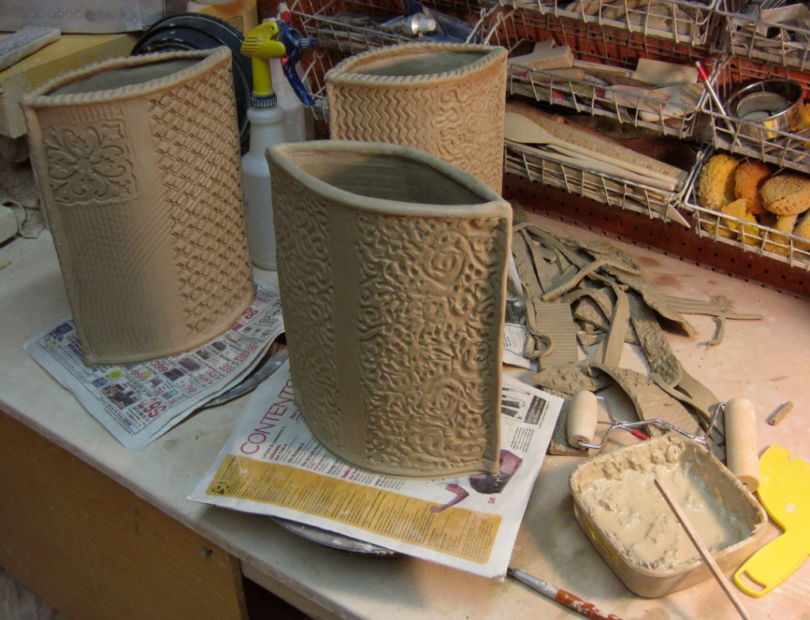
Interesting Slab Shapes:

Slide 13
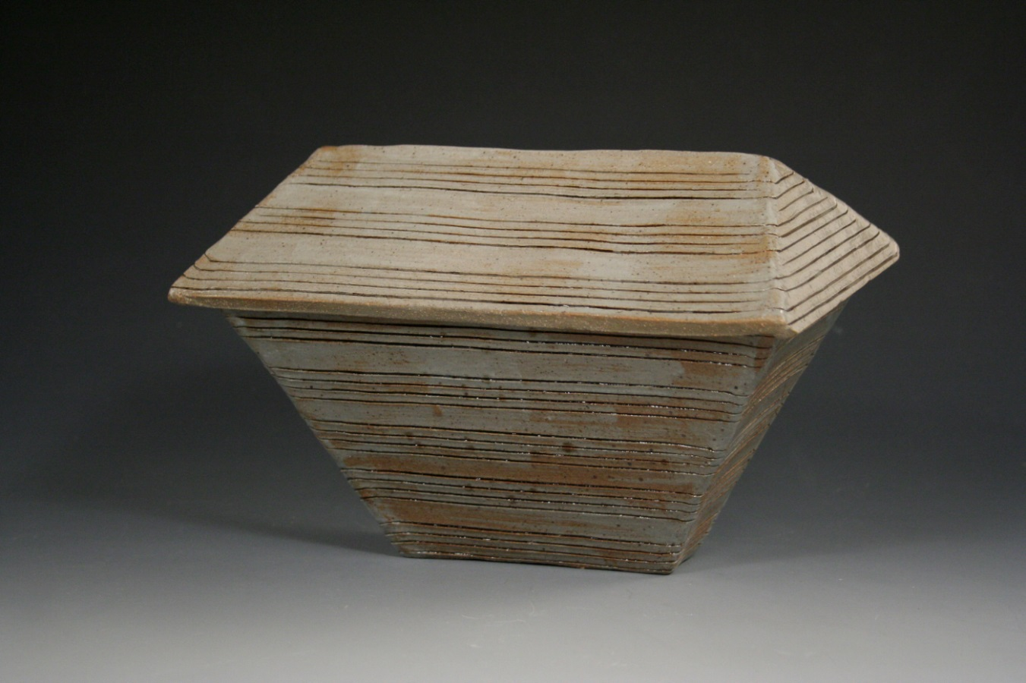

Slide 14
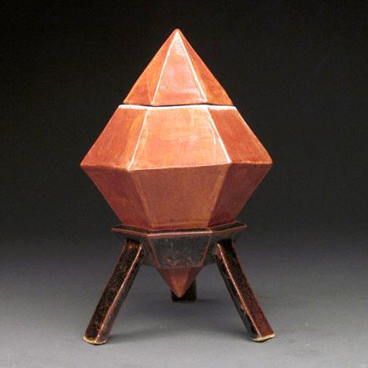

Slide 15
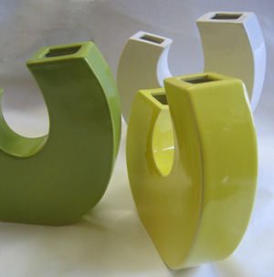

Slide 16
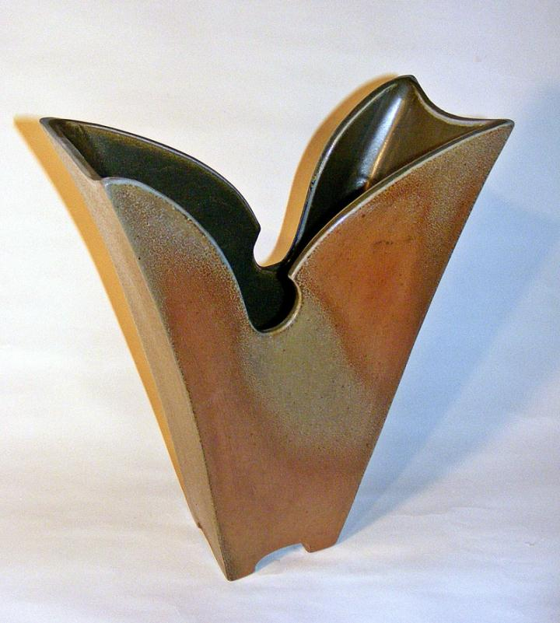

Slide 17
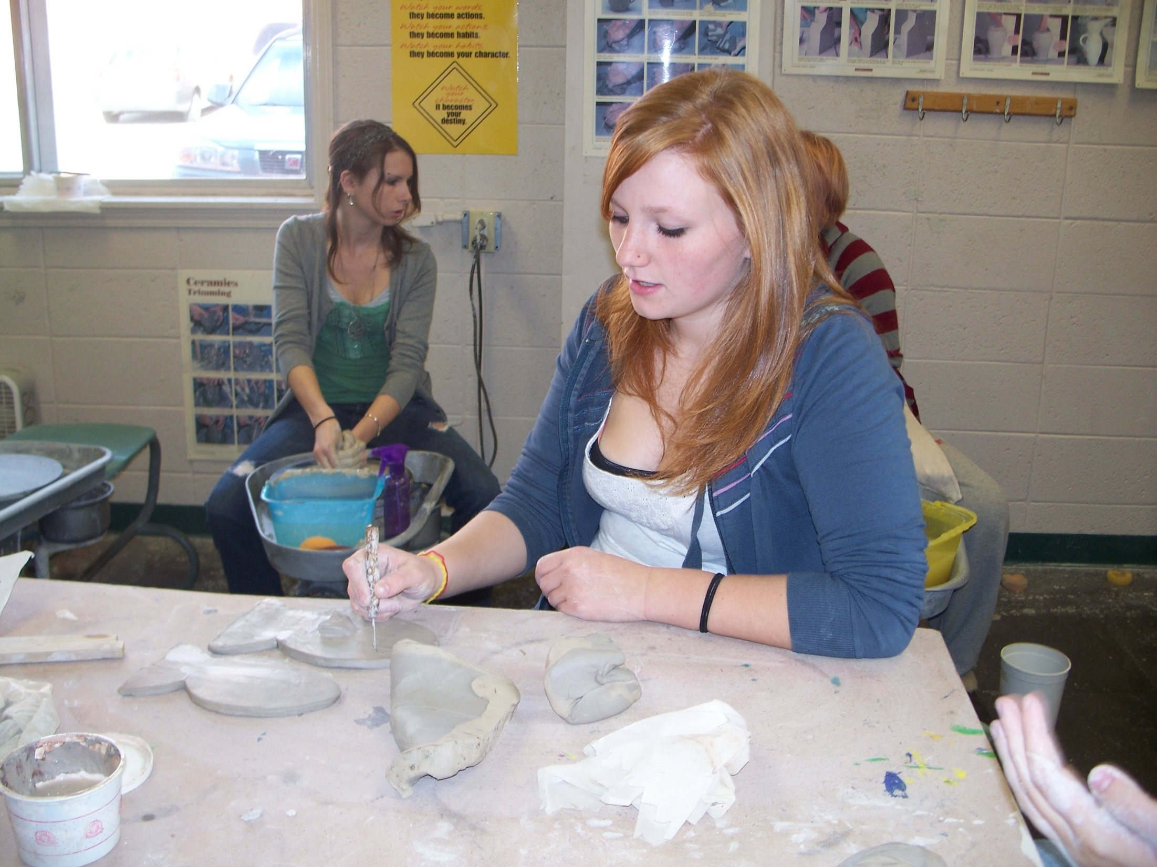

Slide 18
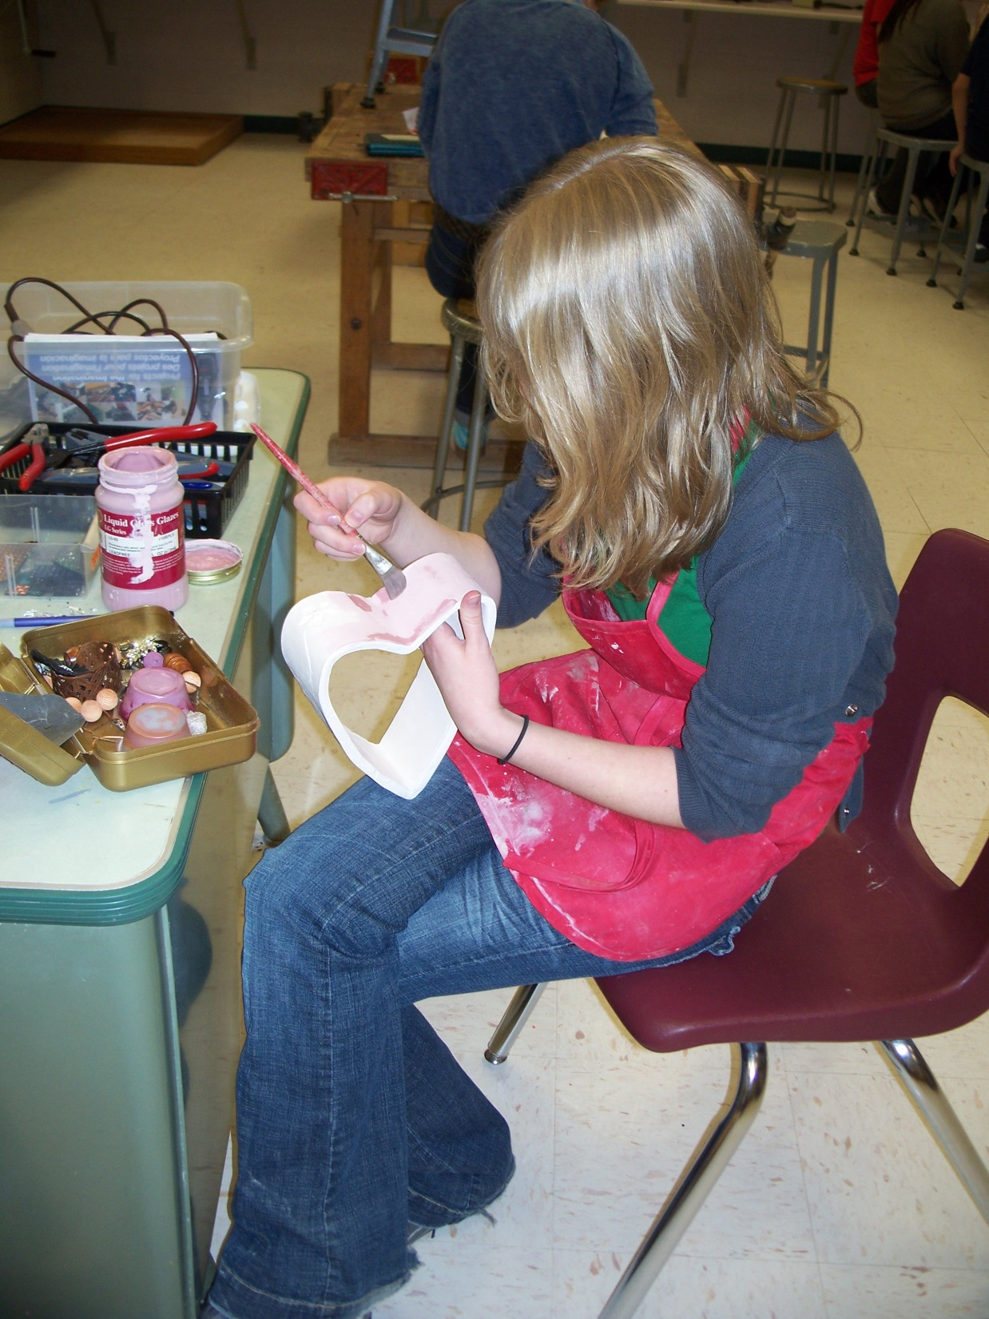
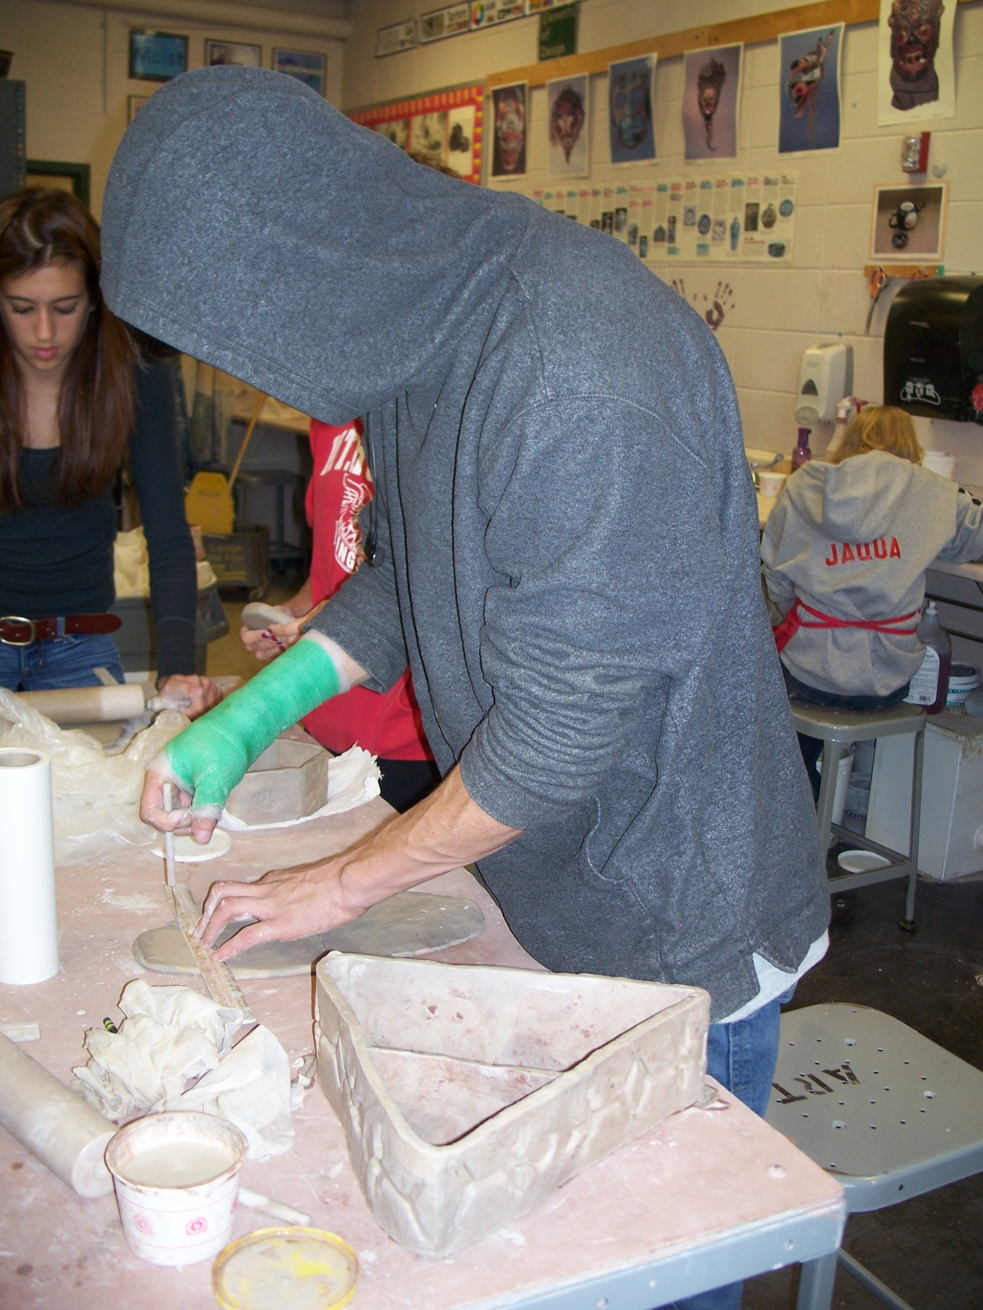

Slide 19
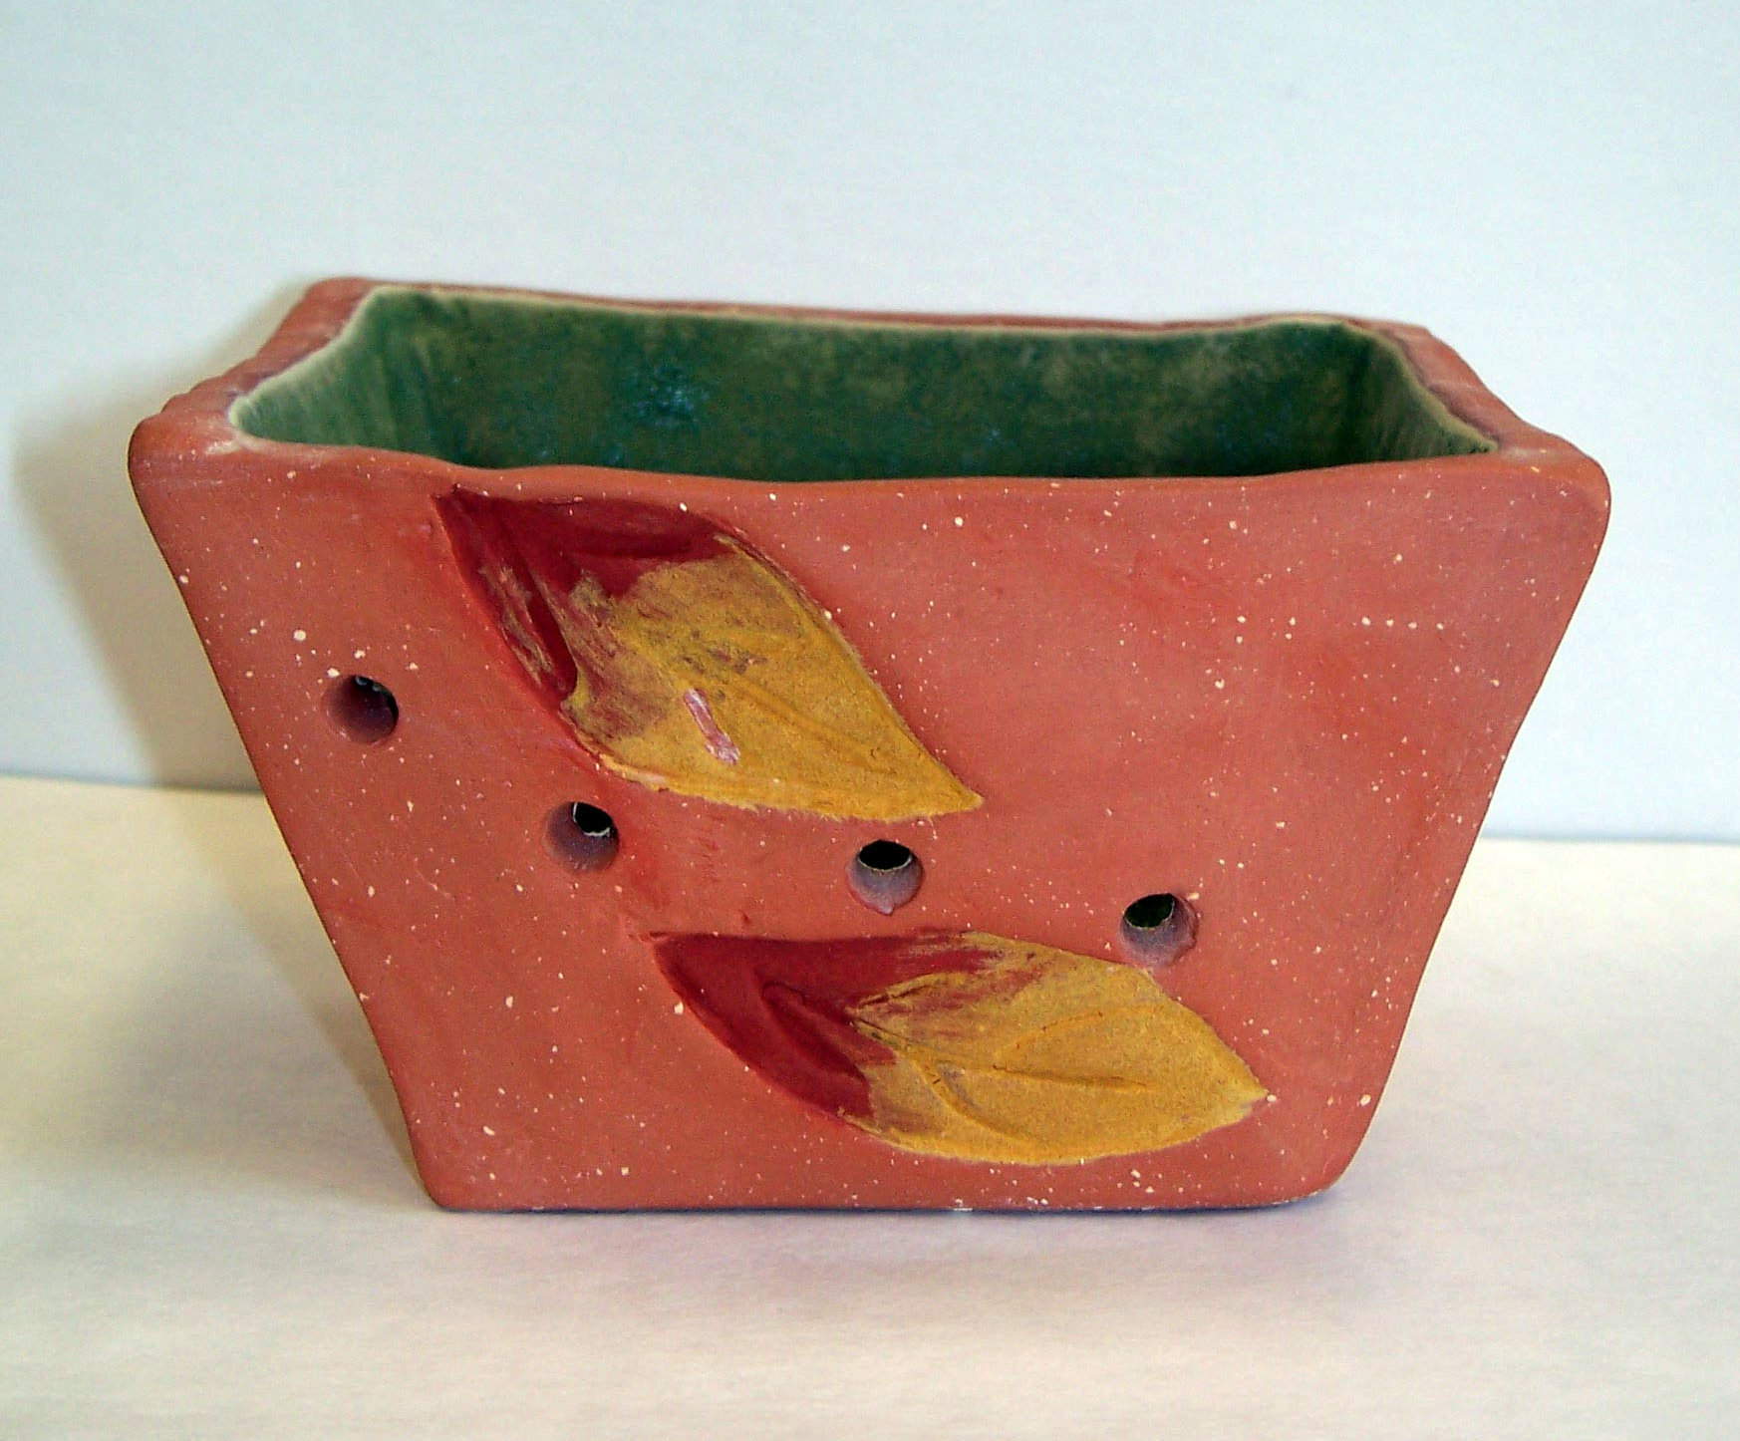

Slide 20
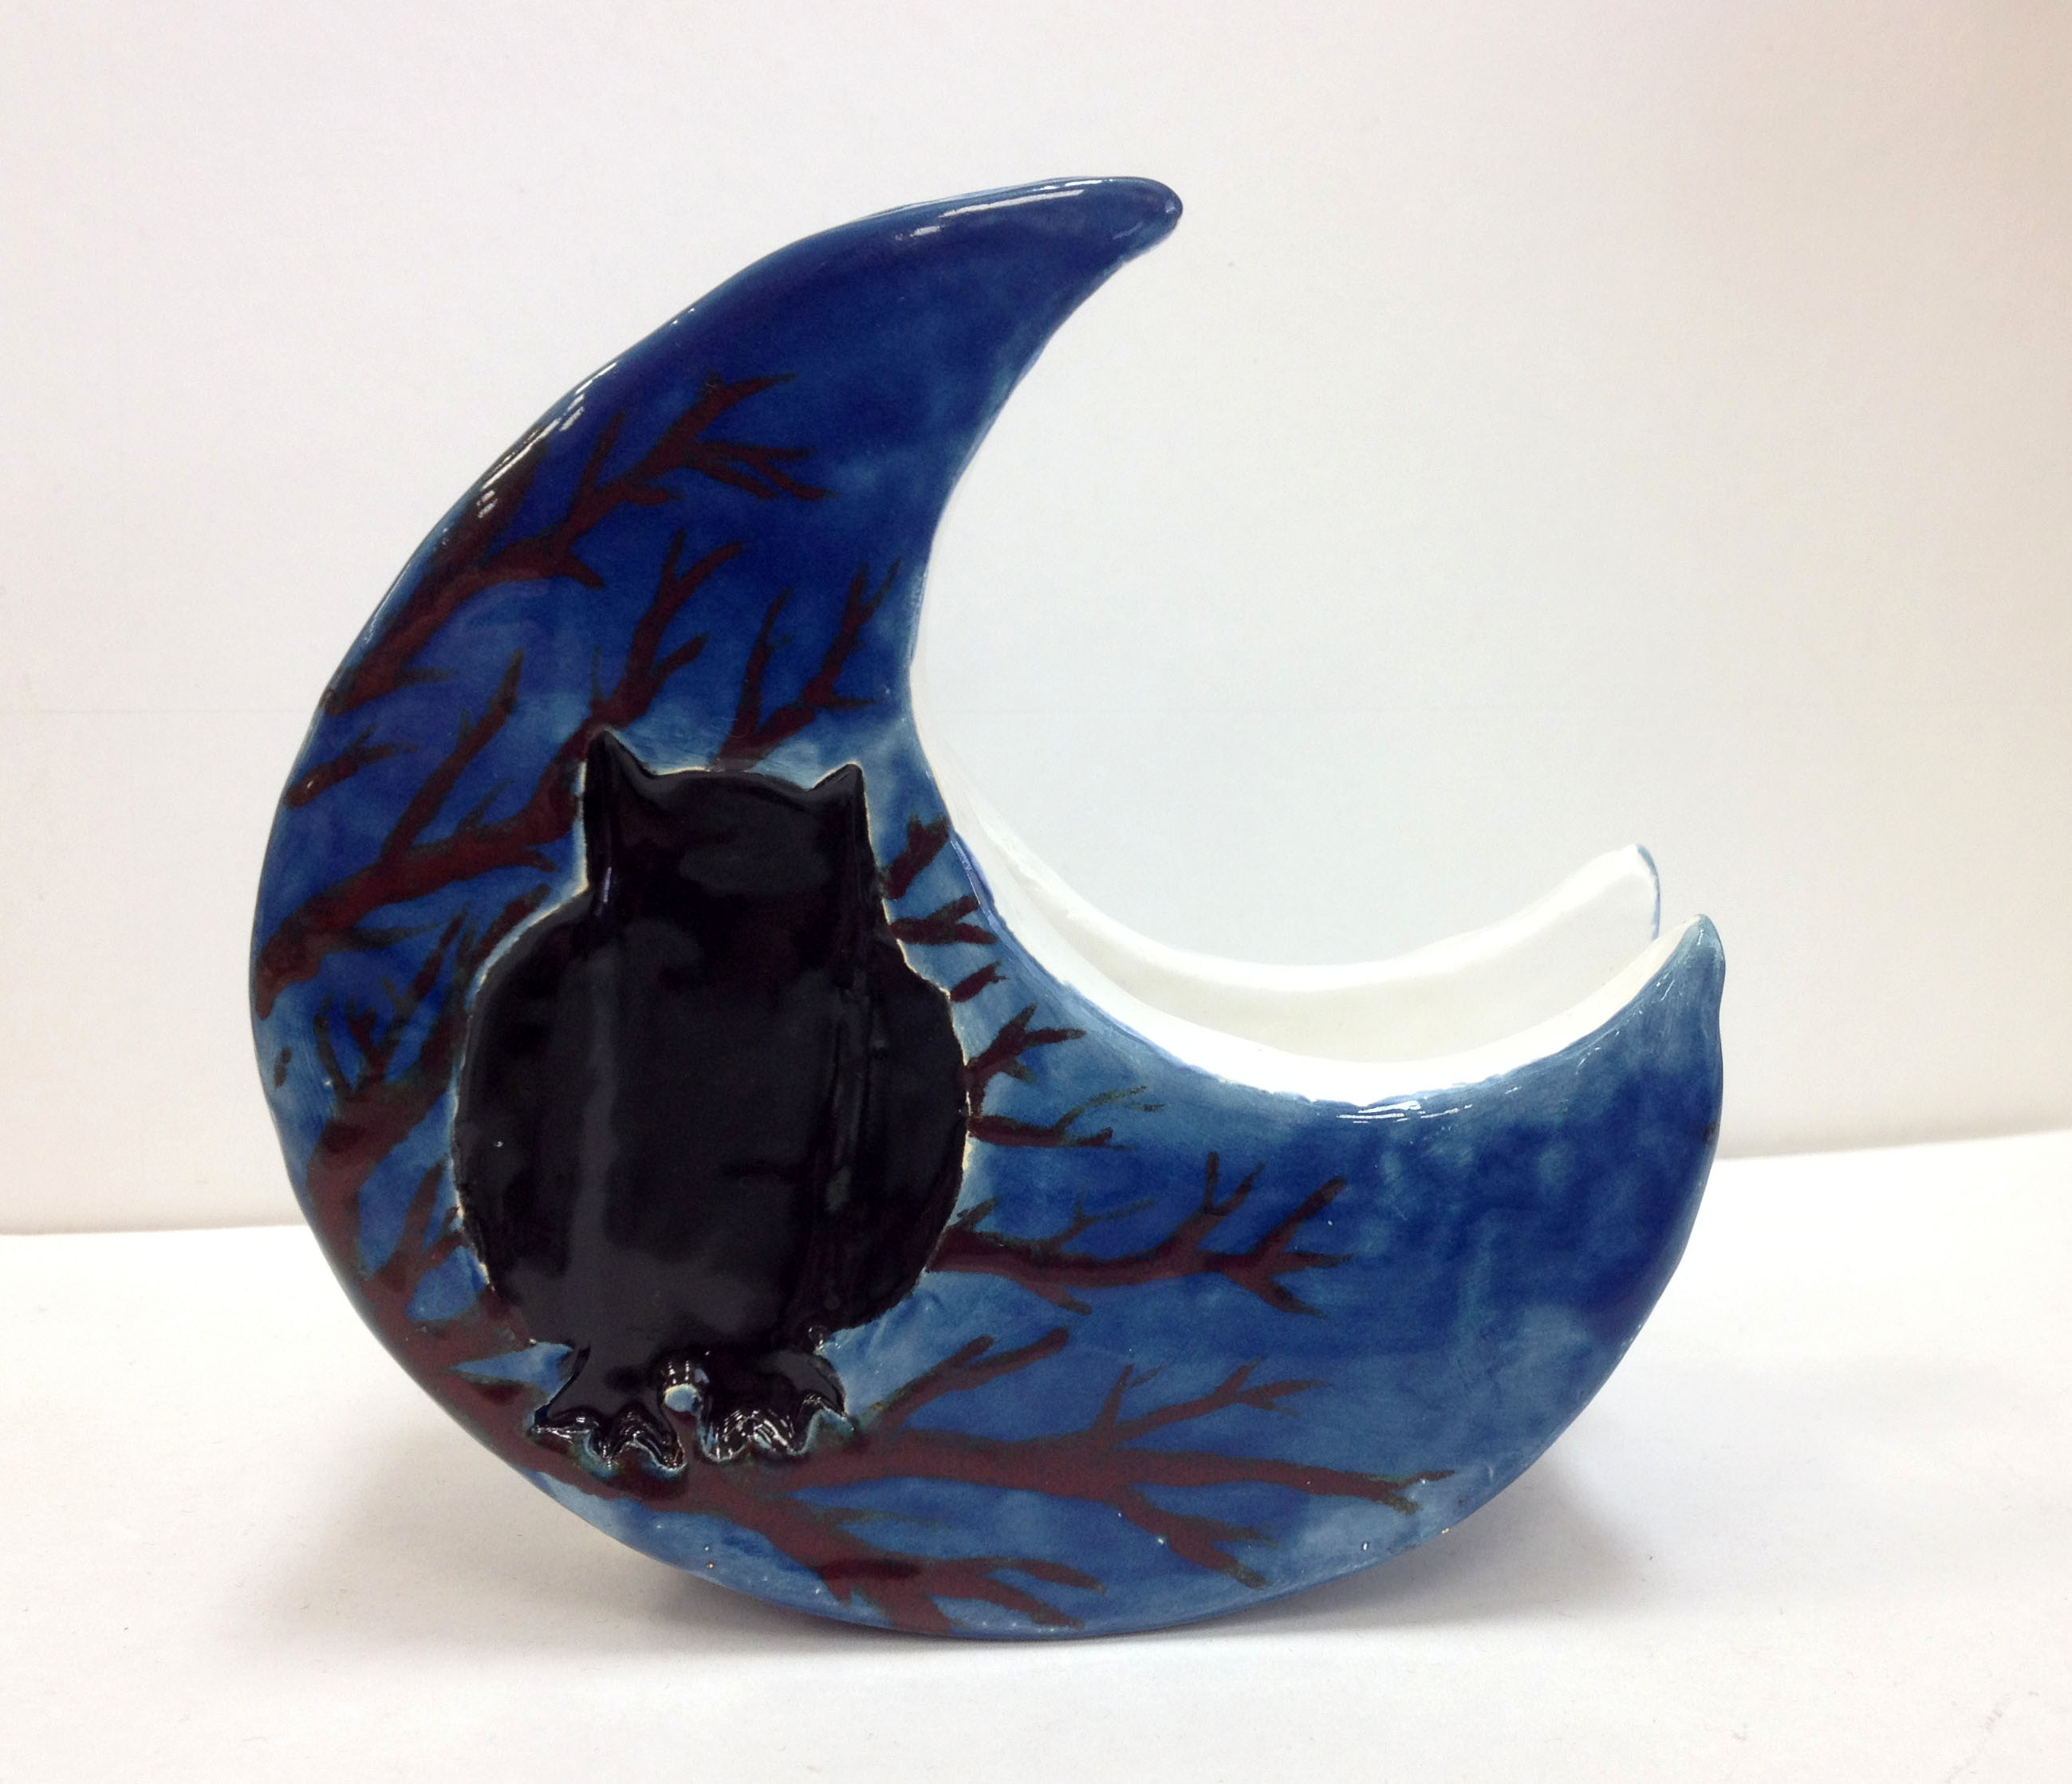

Slide 21
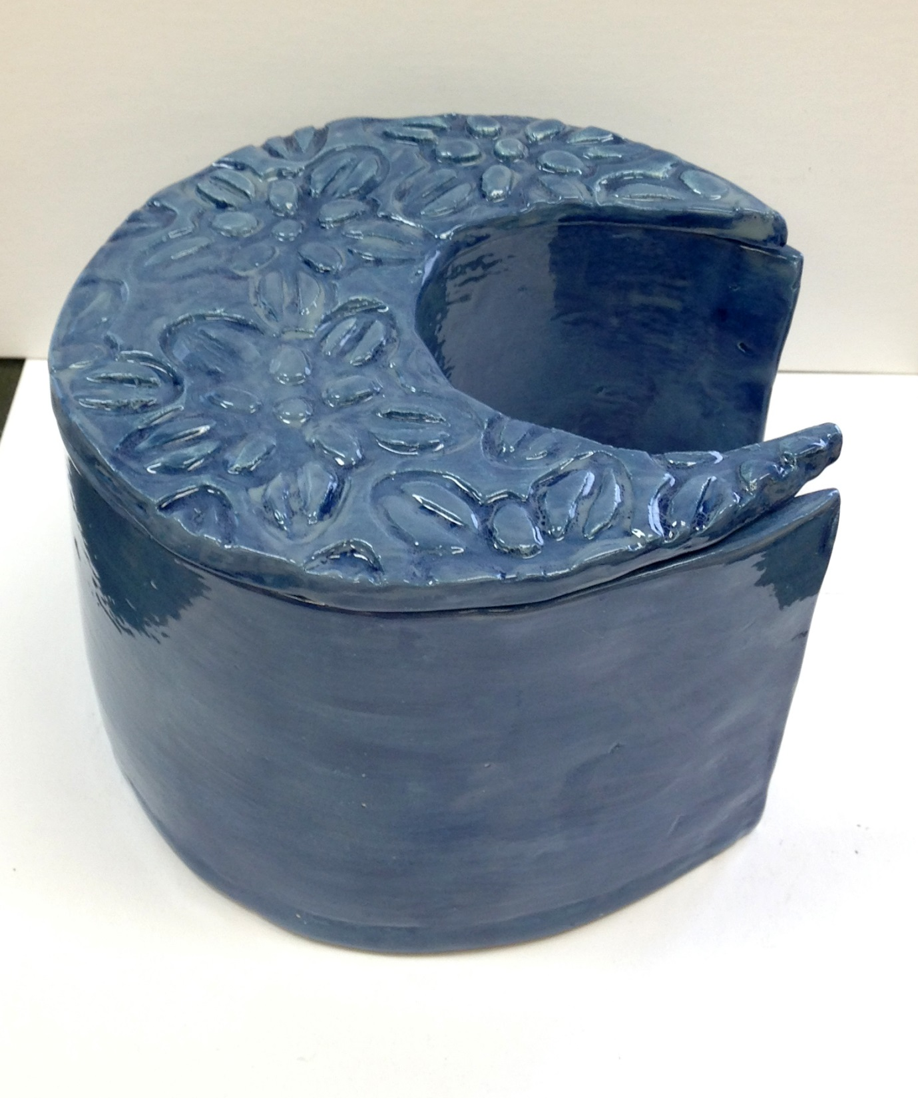

Slide 22
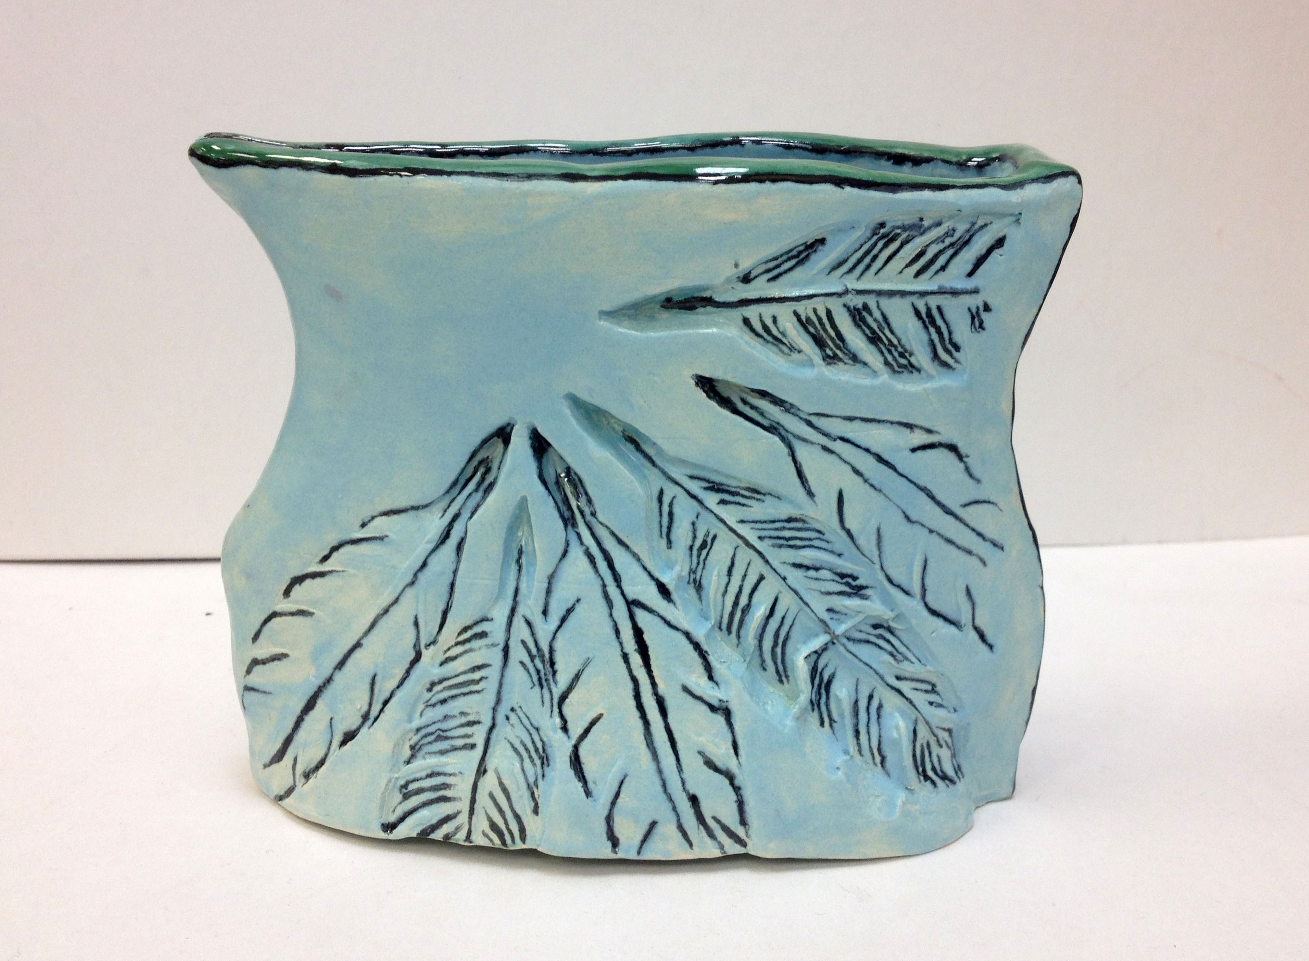

Slide 23
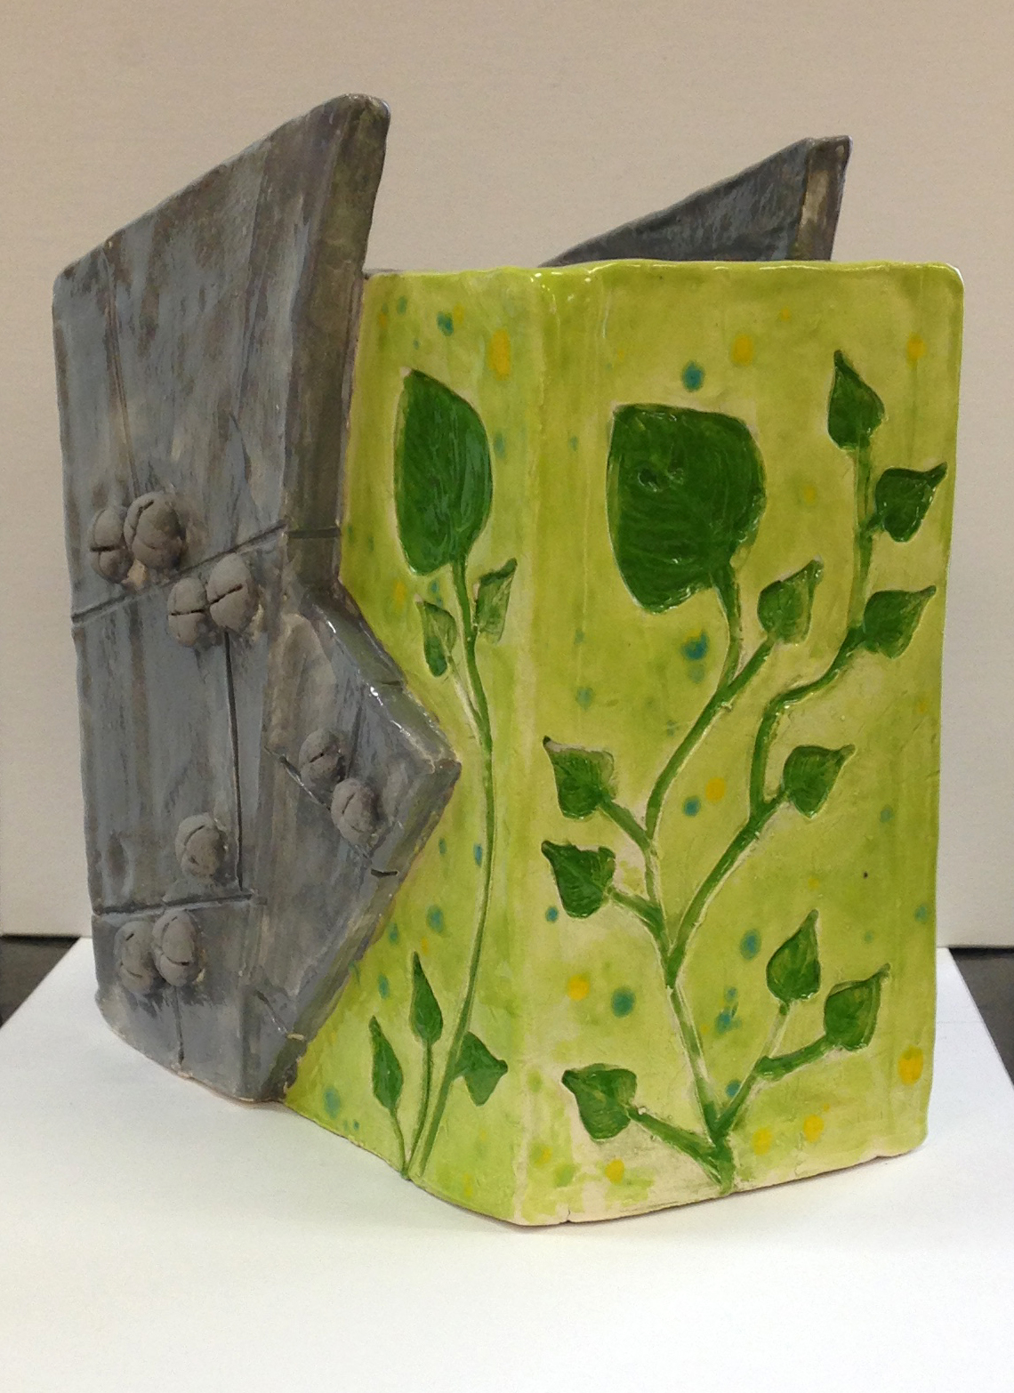

Slide 24
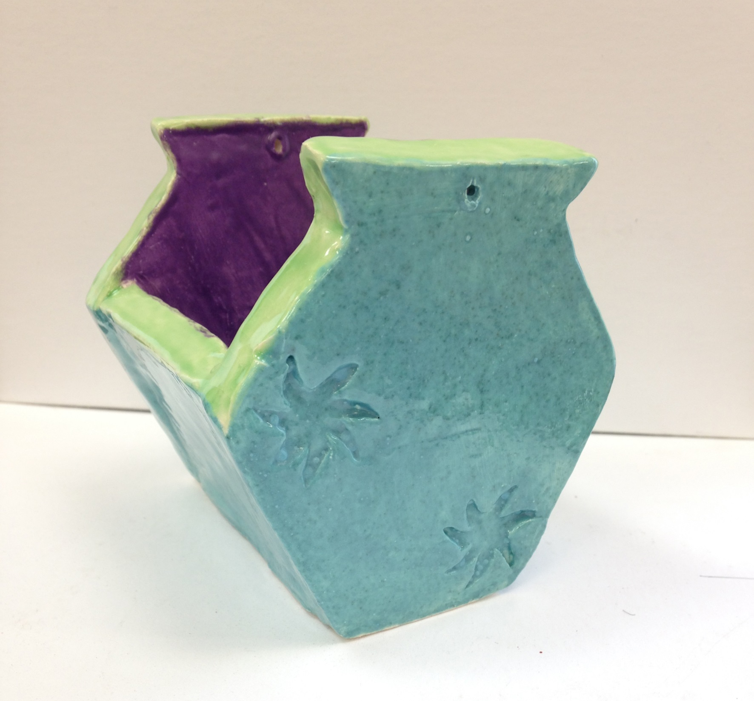

Slide 25
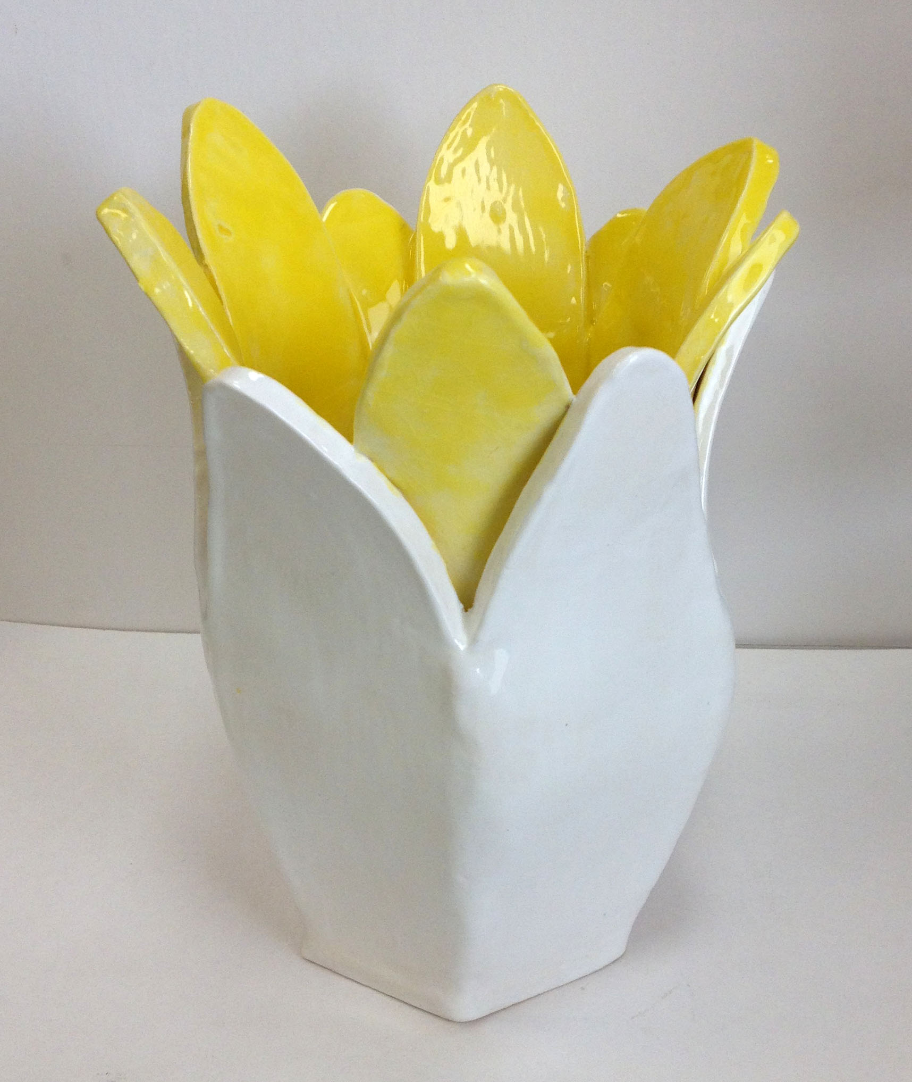

Slide 26
